Slide 1
comwrap IPB Project

Slide 2
General Architecture
Comwrap_ASIL
MSG3_Sig1 +qi
MSG3_Sig2 +qi
MSG3_E2E
MSG3_Sig3 +qi
Signals to inform comwrap_qm about an error, qm needs to set the DTC accordingly
MSG3_BZ
MSG3_Sig1_SigErrorValue
MSG3_TO
MSG3_CRC
Comwrap_QM
Connection to DemWrap
MSG2
MSG2_Sig1 +qi
MSG1
MSG1_Sig1 +qi

Slide 3
comwrap_qm requirements
The SWC comwrap_qm shall route the signals from basic software module com to the application.
The SWC comwrap_qm shall route the signals from application to the com.
For every CAN receive signal a separate application port shall be created.
Signal + Qualifier
For every CAN transmit signal a separate application port shall be created.
The SWC comwrap_qm shall monitor the CAN receive signals for the following error if applicable and needed:
Signal error value
Signal range or
Signal/Message timeout error
SequenceCounter error
CRC error
If one of the above errors is detected of a signal or message, the related signal qualifier shall be set to Signal_Error.
The SWC comwrap_qm shall implement the error qualification and setting of the DTC.
For detailed description of the qualifier handling check slide “Signal Qualifier”

Slide 4
comwrap_asil requirements
The SWC comwrap_asil shall route the signals from basic software module com to the application.
For every CAN receive signal a separate application port shall be created.
Signal + Qualifier
For every CAN transmit signal a separate application port shall be created.
The SWC comwrap_asil shall monitor the CAN receive signals for the following error if applicable and needed:
Signal error value
Signal range or
Signal/Message timeout error
SequenceCounter error
CRC error
If one of the above errors is detected of a signal or message, the related signal qualifier shall be set to Signal_Error.
The SWC comwrap_asil shall implement the error qualification, but shall not set the DTC into the DEM directly.
For every DTC an application port shall be implemented from comwrap_asil to comwrap_qm
The port shall be of type AI_Active
The port shall be set to Active when the error is qualified, according to DTC masterlist.

Slide 5
Error Detection
Signal error value
When the received CAN signal has the error or SNA value predefined in the CAN database
Signal range
When the received CAN signal is outside of the predefined range of the CAN database
Signal/Message timeout error
When the return value of the delegation port has the value MAX_AGE_EXCEEDED
Timeout monitoring will be done by com module
SequenceCounter error
The error is part of the E2E protection
According to the used Autosar implementation, used Profile and customer requirements the error shall be set
Detailed definition necessary
CRC error
The error is part of the E2E protection
When a CRC error is detected the qi error shall be set

Slide 6
Signal Qualifier
Every application port shall have a signal qualifier with the following information
Signal_Init
Signal was never received since the CAN was activated
Signal_OK
Signal was received and updated in the last x ms
The time Signal_OK is set, needs to be defined by application component
Signal_NotActive
When time x ms is expired the qi shall be set to Not_Active
X needs is dependend on the receiving SWC cycletime and the signals/message cycletime
When CAN is deactivated the qi shall be set to Not_Active
Signal_Error
When an error like TimeOut, E2E, ErrorValue, ValueRange occures the qi shall be set to Error

Slide 7
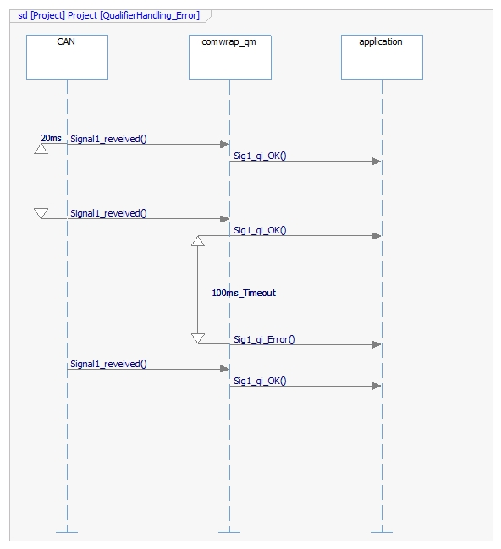
Example qualifier handling Error

Slide 8
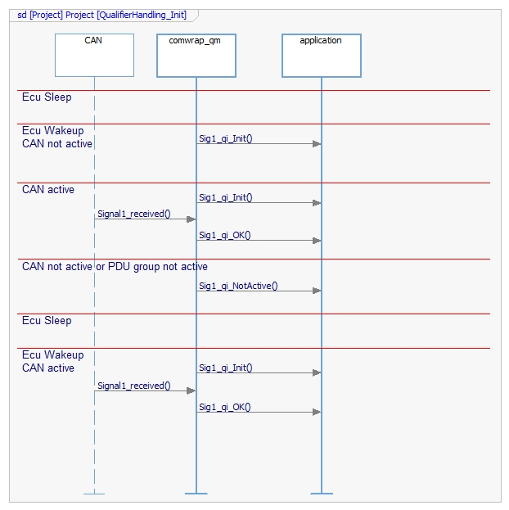
Example qualifier handling Init

Slide 9
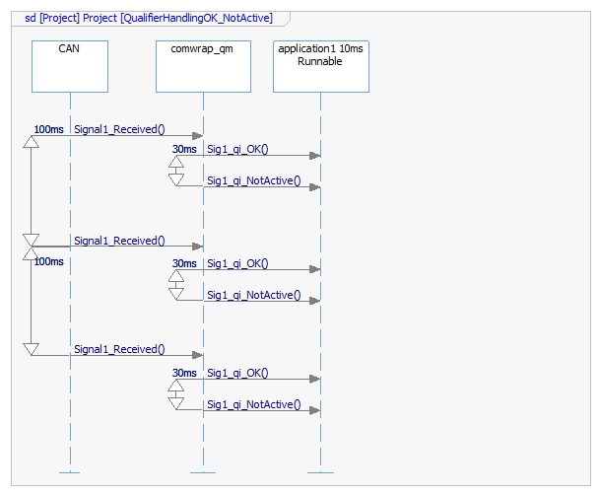
Example qualifier handling OK/NotActive

Slide 10
IPB comwrap_qm/asil extension phases
The comwrap module shall be implemented in three phases
Phase 1:
Routing of signals from CAN to Application
Routing of siganls from Application to CAN
No Error detection or qualifier handling shall be implemented
Phase 2:
Qualifier handling shall be fully supported as described on slide „Signal Qualifier“
Error detection shall be implemented as described on slide „Error Detection“
Phase 3:
DTC shall be set

Slide 11
Smarter. Greener. Together.

